Slide 1

Introduction to Machine Learning
Topic 5 – Tree-based methods
(HOML Ch. 6 & 7)
Master in Quantitative Economic Analysis MQuEA
Javier Bas
Universidad Autónoma de Madrid

Slide 2
Outline
Decision trees
  Decision trees regression
  Decision trees classification
  Regularization hyperparameters
  Trees vs. Linear models
Ensemble methods and Random Forests
  Voting classifiers
  Bagging
  Random Forests
  Extremely Randomized Forests
  Boosting
Master in Quantitative Economic Analysis MQuEA
Universidad Autónoma de Madrid

Slide 3
Decision Trees
Tree-based methods stratify, or segment, the feature space into smaller regions
The mean or the mode of the instances that fall into a region is used to classify an observation
That classification, the splitting into regions, takes the form of “tree”
They are suitable for both regression and classification
Nodes
Leaves
Source: Hitters dataset
Source: Heart dataset
Master in Quantitative Economic Analysis MQuEA
Universidad Autónoma de Madrid

Slide 4



Decision Trees
$$R_{3}=\left\{X|Years≥4.5, Hits≥117.5\right\}$$
$$R_{1}=\left\{X|Years<4.5\right\}$$
$$R_{2}=\left\{X|Years≥4.5, Hits<117.5\right\}$$
Master in Quantitative Economic Analysis MQuEA
Universidad Autónoma de Madrid

Slide 5
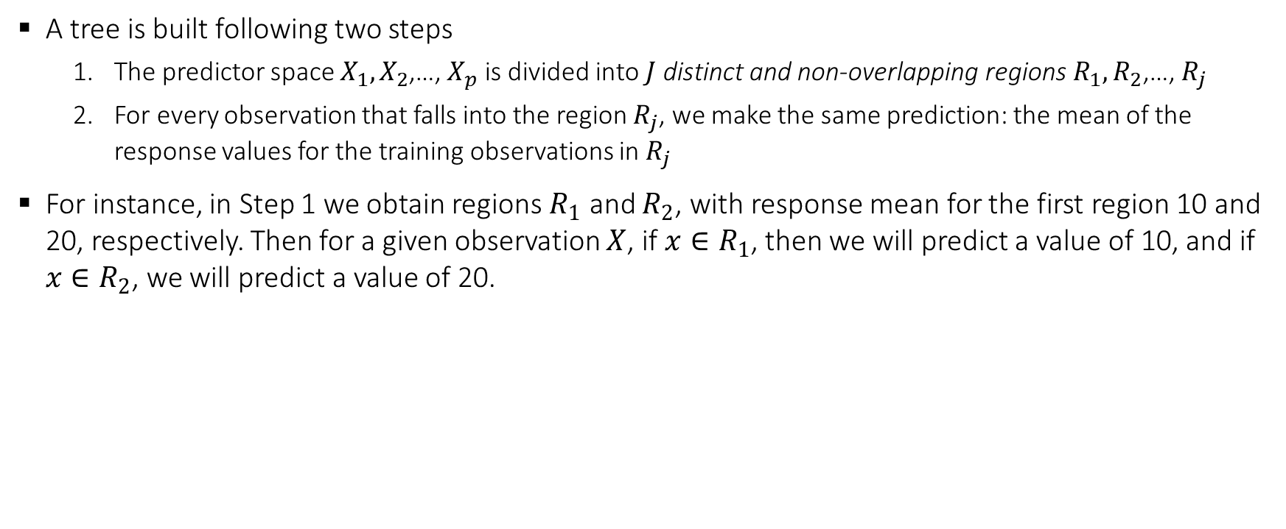
Decision Trees - Regression
A tree is built following two steps
  The predictor space $X_{1},X_{2}$,…, $X_{p}$ is divided into $J$ distinct and non-overlapping regions $R_{1},R_{2}$,…, $R_{j}$
  For every observation that falls into the region $R_{j}$, we make the same prediction: the mean of the response values for the training observations in $R_{j}$
For instance, in Step 1 we obtain regions $R_{1}$ and $R_{2}$, with response mean for the first region 10 and 20, respectively. Then for a given observation $X$, if $x∈R_{1}$, then we will predict a value of 10, and if $x∈R_{2}$, we will predict a value of 20.
Master in Quantitative Economic Analysis MQuEA
Universidad Autónoma de Madrid

Slide 6
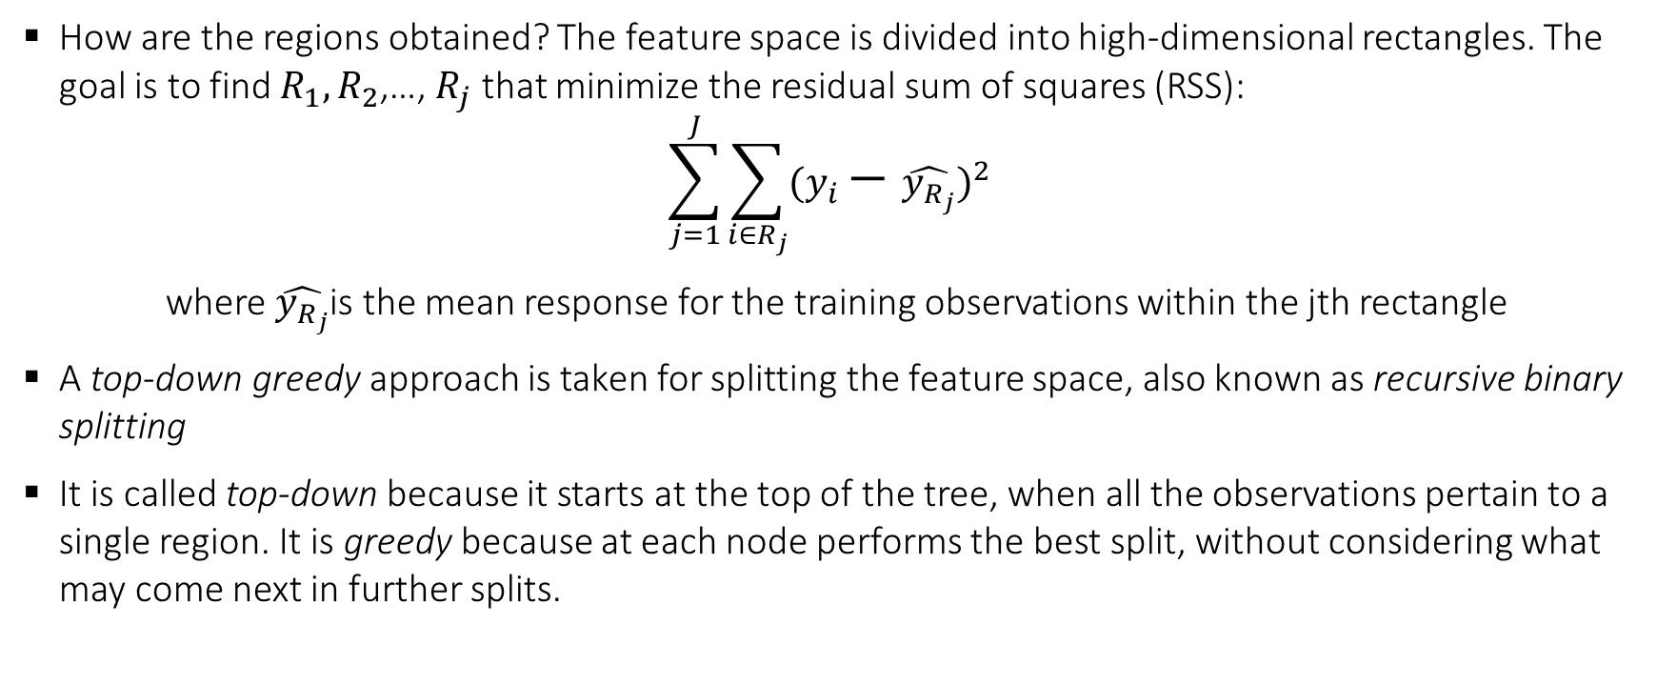
Decision Trees - Regression
How are the regions obtained? The feature space is divided into high-dimensional rectangles. The goal is to find $R_{1},R_{2}$,…, $R_{j}$ that minimize the residual sum of squares (RSS):
$$\sum_{j=1}^{J}{\sum_{i∈R_{j}}{{(y_{i}−\hat{y_{R_{j}}})}^{2}}}$$
where $\hat{y_{R_{j}}}$is the mean response for the training observations within the jth rectangle
A top-down greedy approach is taken for splitting the feature space, also known as recursive binary splitting
It is called top-down because it starts at the top of the tree, when all the observations pertain to a single region. It is greedy because at each node performs the best split, without considering what may come next in further splits.
Master in Quantitative Economic Analysis MQuEA
Universidad Autónoma de Madrid

Slide 7
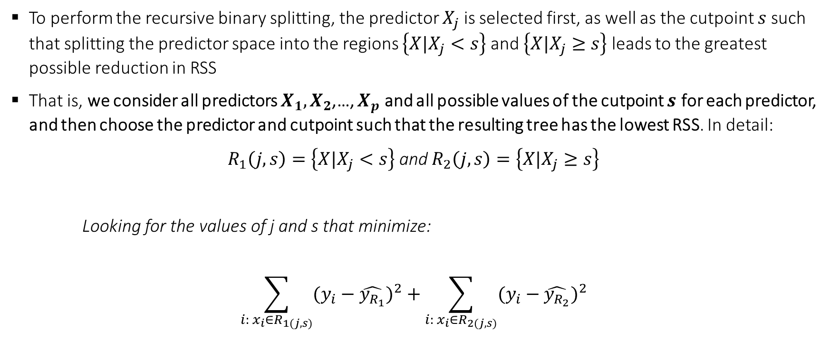
Decision Trees - Regression
To perform the recursive binary splitting, the predictor $X_{j}$ is selected first, as well as the cutpoint $s$ such that splitting the predictor space into the regions $\left\{X|X_{j}<s\right\}$ and $\left\{X|X_{j}≥s\right\}$ leads to the greatest possible reduction in RSS
That is, we consider all predictors $X_{1},X_{2}$,…, $X_{p}$ and all possible values of the cutpoint $s$ for each predictor, and then choose the predictor and cutpoint such that the resulting tree has the lowest RSS. In detail:
$R_{1}\left(j,s\right)=\left\{X|X_{j}<s\right\}$ and $R_{2}\left(j,s\right)=\left\{X|X_{j}≥s\right\}$
Looking for the values of j and s that minimize:
$$\sum_{i: x_{i}∈R_{1(j,s)}}{{(y_{i}−\hat{y_{R_{1}}})}^{2}}+\sum_{i: x_{i}∈R_{2(j,s)}}{{(y_{i}−\hat{y_{R_{2}}})}^{2}}$$
Master in Quantitative Economic Analysis MQuEA
Universidad Autónoma de Madrid

Slide 8
Decision Trees - Regression
Next, we repeat the process looking for the best predictor and cutpoint in order to split the data further so as to minimize the RSS within each of the resulting regions.
Now that we have three regions, we look to split one of them the further as to minimize RSS….
The process continues until a stopping criterion is reached, for instance, that a region contains less than 5 observations.
Master in Quantitative Economic Analysis MQuEA
Universidad Autónoma de Madrid

Slide 9
Decision Trees - Regression
In reality, this procedure produces ”complex” (deep) trees that tend to overfit the data
Since simpler ones can generalize better (incurring in some bias, though), a process named pruning is usually performed
By pruning a tree some branches are removed, helping in achieving a reasonable accuracy without overfiting. K-fold cross validation is involved in the process of pruning a tree
Unpruned tree (a pruned one is in the first slide)
Master in Quantitative Economic Analysis MQuEA
Universidad Autónoma de Madrid

Slide 10
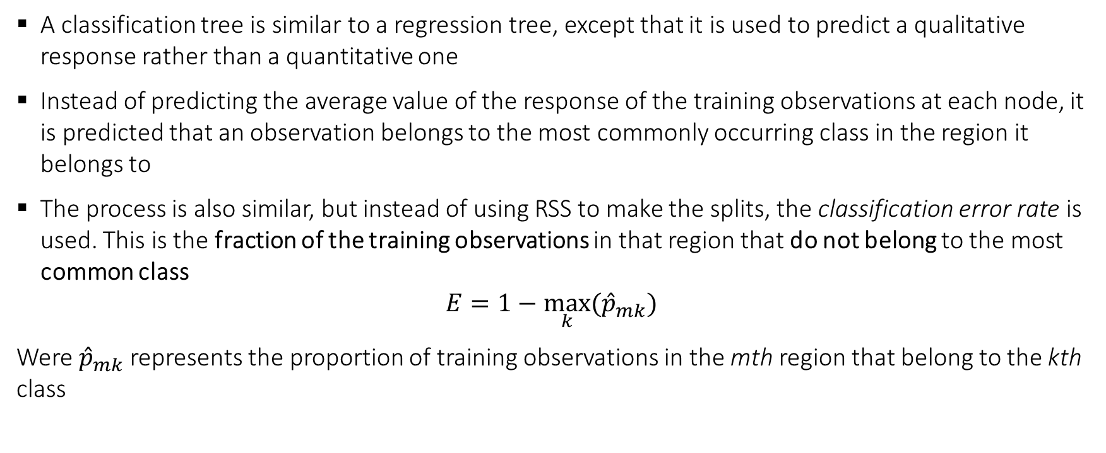
Decision Trees - Classification
A classification tree is similar to a regression tree, except that it is used to predict a qualitative response rather than a quantitative one
Instead of predicting the average value of the response of the training observations at each node, it is predicted that an observation belongs to the most commonly occurring class in the region it belongs to
The process is also similar, but instead of using RSS to make the splits, the classification error rate is used. This is the fraction of the training observations in that region that do not belong to the most common class
$$E=1−\max_{k}{{(\hat{p}}_{mk})}$$
Were ${\hat{p}}_{mk}$ represents the proportion of training observations in the mth region that belong to the kth class
Master in Quantitative Economic Analysis MQuEA
Universidad Autónoma de Madrid

Slide 11
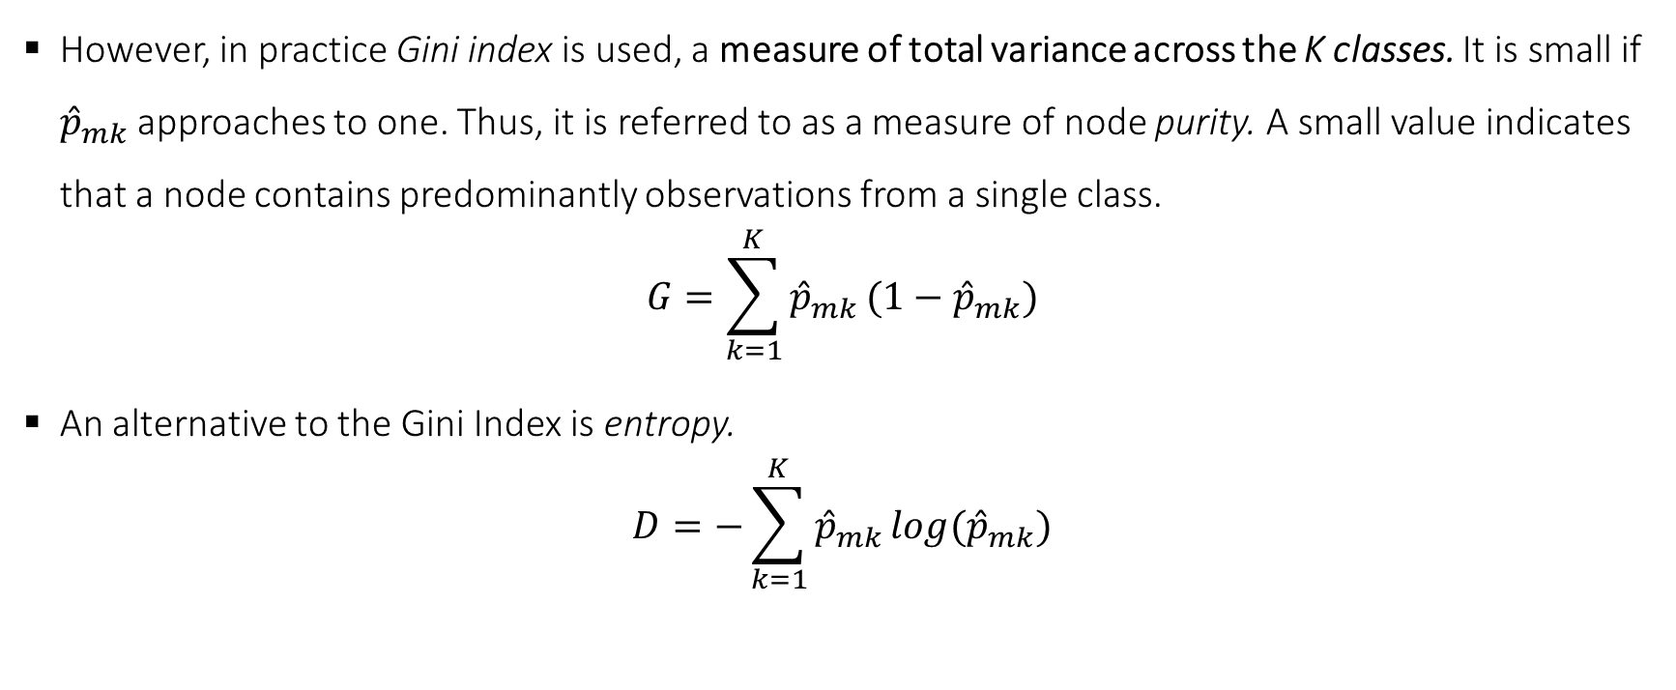
Decision Trees - Classification
However, in practice Gini index is used, a measure of total variance across the K classes. It is small if ${\hat{p}}_{mk}$ approaches to one. Thus, it is referred to as a measure of node purity. A small value indicates that a node contains predominantly observations from a single class.
$$G=\sum_{k=1}^{K}{{\hat{p}}_{mk}}(1−{\hat{p}}_{mk})$$
An alternative to the Gini Index is entropy.
$$D=−\sum_{k=1}^{K}{{\hat{p}}_{mk}}log{(\hat{p}}_{mk})$$
Master in Quantitative Economic Analysis MQuEA
Universidad Autónoma de Madrid

Slide 12
Decision Trees - Classification
unpruned
pruned
Master in Quantitative Economic Analysis MQuEA
Universidad Autónoma de Madrid

Slide 13
Decision Trees - Regularization
As mentioned, decision trees make very few assumptions about the training data. Hence, if left unconstrained, they will adapt to the data, fitting very closely (overfitting)
An Alternative to pruning to avoid overfitting, it is possible to restrict the Decision tree freedom during training via its hyperparameters. This is called regularization
It is possible to tweak:
  max_depth: maximum depth (nodes) of the trees
  min_samples_split: minimum number of samples a node must have before splitting it
  min_samples_leaf: minimum number of samples a leaf node must have
  max_leaf_nodes: maximum number of leafs nodes
  max_features: maximum number of features evaluated for splitting
Master in Quantitative Economic Analysis MQuEA
Universidad Autónoma de Madrid

Slide 14
Decision Trees Vs Linear models
Best model depends on the problem at hand
Trees are easy to explain
Trees might be closer to human decision-making process
Trees can be displayed graphically and be easy of interpret
Trees can easily handle qualitative features without dummyfying
However…
Trees do not have the same level of prediction accuracy as other methods
Trees are not robust
Master in Quantitative Economic Analysis MQuEA
Universidad Autónoma de Madrid

Slide 15
Ensemble methods
Trees are simple and interpretable. But they cannot compete with other techniques in terms of prediction accuracy
But what if we could produce multiple trees and combine them to yield a single consensus prediction? This is called an Ensemble
Combining many trees often results in a dramatic improvement in prediction accuracy (at the expense of some interpretation)
Master in Quantitative Economic Analysis MQuEA
Universidad Autónoma de Madrid

Slide 16
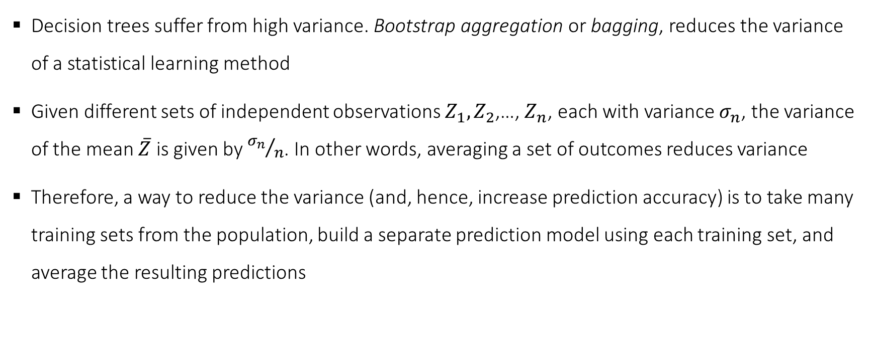
Ensemble methods – Bagging
Decision trees suffer from high variance. Bootstrap aggregation or bagging, reduces the variance of a statistical learning method
Given different sets of independent observations $Z_{1},Z_{2}$,…, $Z_{n}$, each with variance $σ_{n}$, the variance of the mean $\overline{Z}$ is given by ${σ_{n}}/n$. In other words, averaging a set of outcomes reduces variance
Therefore, a way to reduce the variance (and, hence, increase prediction accuracy) is to take many training sets from the population, build a separate prediction model using each training set, and average the resulting predictions
Master in Quantitative Economic Analysis MQuEA
Universidad Autónoma de Madrid

Slide 17
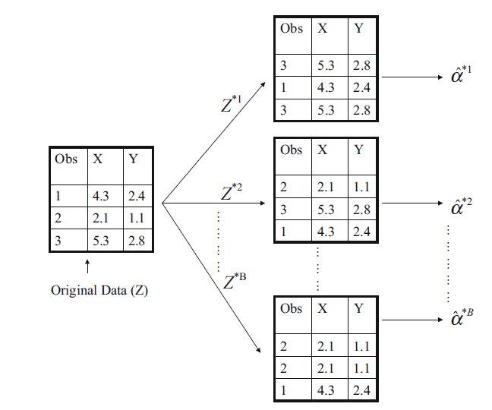
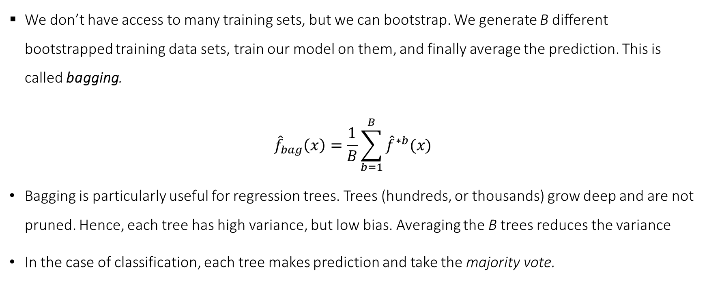
Ensemble methods – Bagging
We don’t have access to many training sets, but we can bootstrap. We generate B different bootstrapped training data sets, train our model on them, and finally average the prediction. This is called bagging.
$${\hat{f}}_{bag}\left(x\right)=\frac{1}{B}\sum_{b=1}^{B}{{\hat{f}}^{∗b}(x)}$$
Bagging is particularly useful for regression trees. Trees (hundreds, or thousands) grow deep and are not pruned. Hence, each tree has high variance, but low bias. Averaging the B trees reduces the variance
In the case of classification, each tree makes prediction and take the majority vote.
Master in Quantitative Economic Analysis MQuEA
Universidad Autónoma de Madrid

Slide 18
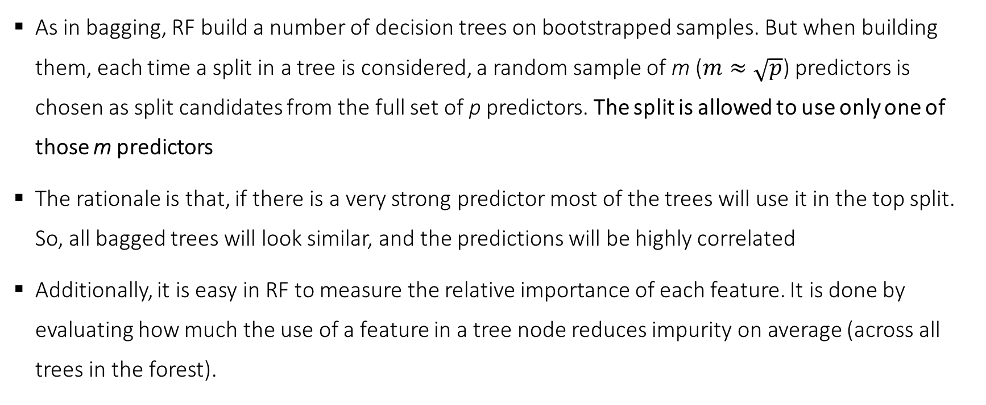
Ensemble methods – Random Forest
As in bagging, RF build a number of decision trees on bootstrapped samples. But when building them, each time a split in a tree is considered, a random sample of m ($m≈\sqrt{p}$) predictors is chosen as split candidates from the full set of p predictors. The split is allowed to use only one of those m predictors
The rationale is that, if there is a very strong predictor most of the trees will use it in the top split. So, all bagged trees will look similar, and the predictions will be highly correlated
Additionally, it is easy in RF to measure the relative importance of each feature. It is done by evaluating how much the use of a feature in a tree node reduces impurity on average (across all trees in the forest).
Master in Quantitative Economic Analysis MQuEA
Universidad Autónoma de Madrid

Slide 19
Ensemble methods – Extremely Randomized Forests
When growing a tree in a RF, at each node only a random subset of the features is considered for splitting
It is possible to make trees even more random by also using random thresholds for each feature rather than searching for the best possible thresholds (remember that splits are selected to minimize resids).
This technique trades more bias for lower variance and makes XRF faster to estimate.
Master in Quantitative Economic Analysis MQuEA
Universidad Autónoma de Madrid

Slide 20
Ensemble methods – Boosting
Boosting works in a similar way than Bagging (train trees on bootstrapped samples and combining results), but the trees are grown sequentially: each tree is built using information from previously grown trees.
However, Boosting does not involve bootstrap sampling; instead, each tree is fit on a modified version of the original dataset, trying to improve it. It learns slowly.
Adaboost and Gradient Boosting are the most popular boosting methods
  Adaboost: A first model is trained and used to make predictions. Then the relative weight of misclassified training instances is increased, to train a second classifier using the updated weights… and so on
  Gradient boosting: Instead of tweaking the instance weights at every iteration, this method fits the new tree to the residual errors made by the previous tree
Master in Quantitative Economic Analysis MQuEA
Universidad Autónoma de Madrid

Slide 21
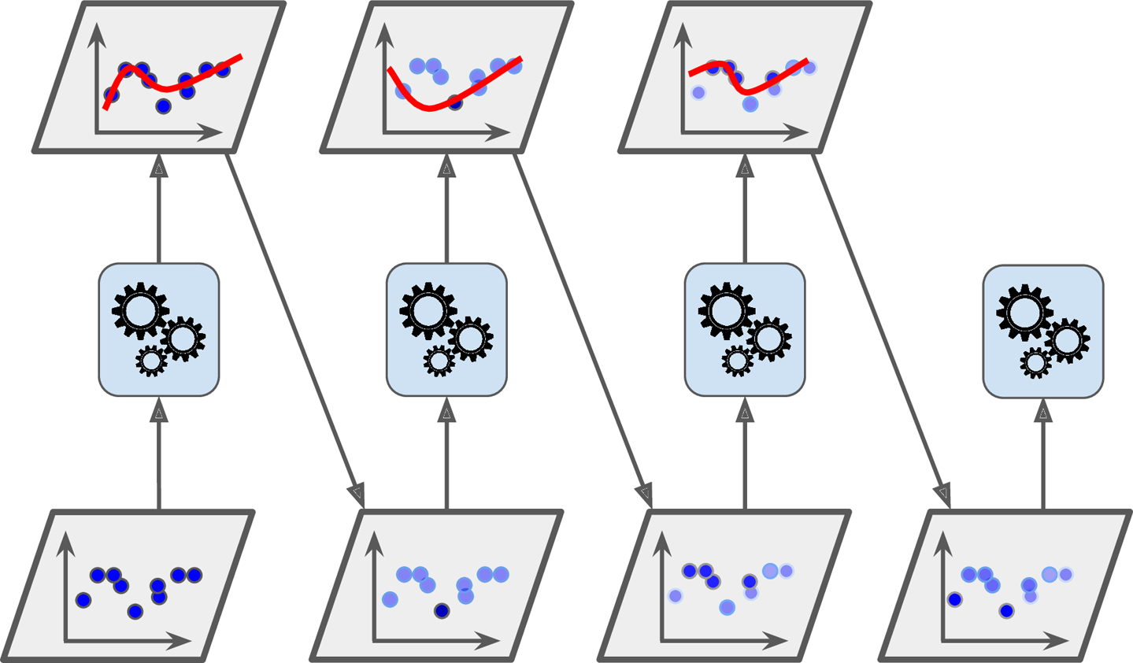
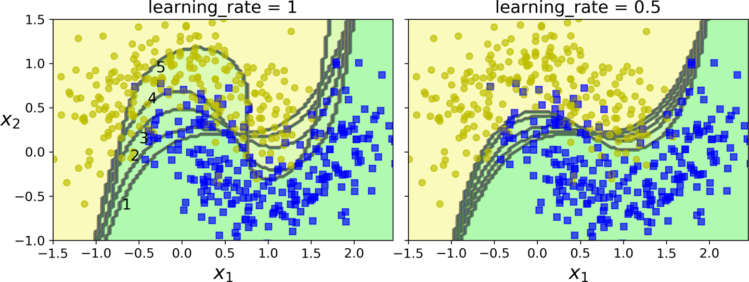
Ensemble methods – Boosting
Source: HOML,Ch. 7 (check for the mathematical details)
Master in Quantitative Economic Analysis MQuEA
Universidad Autónoma de Madrid

